Slide 1
Promoting the value of
ICAEW licensed insolvency practitioners

Slide 2
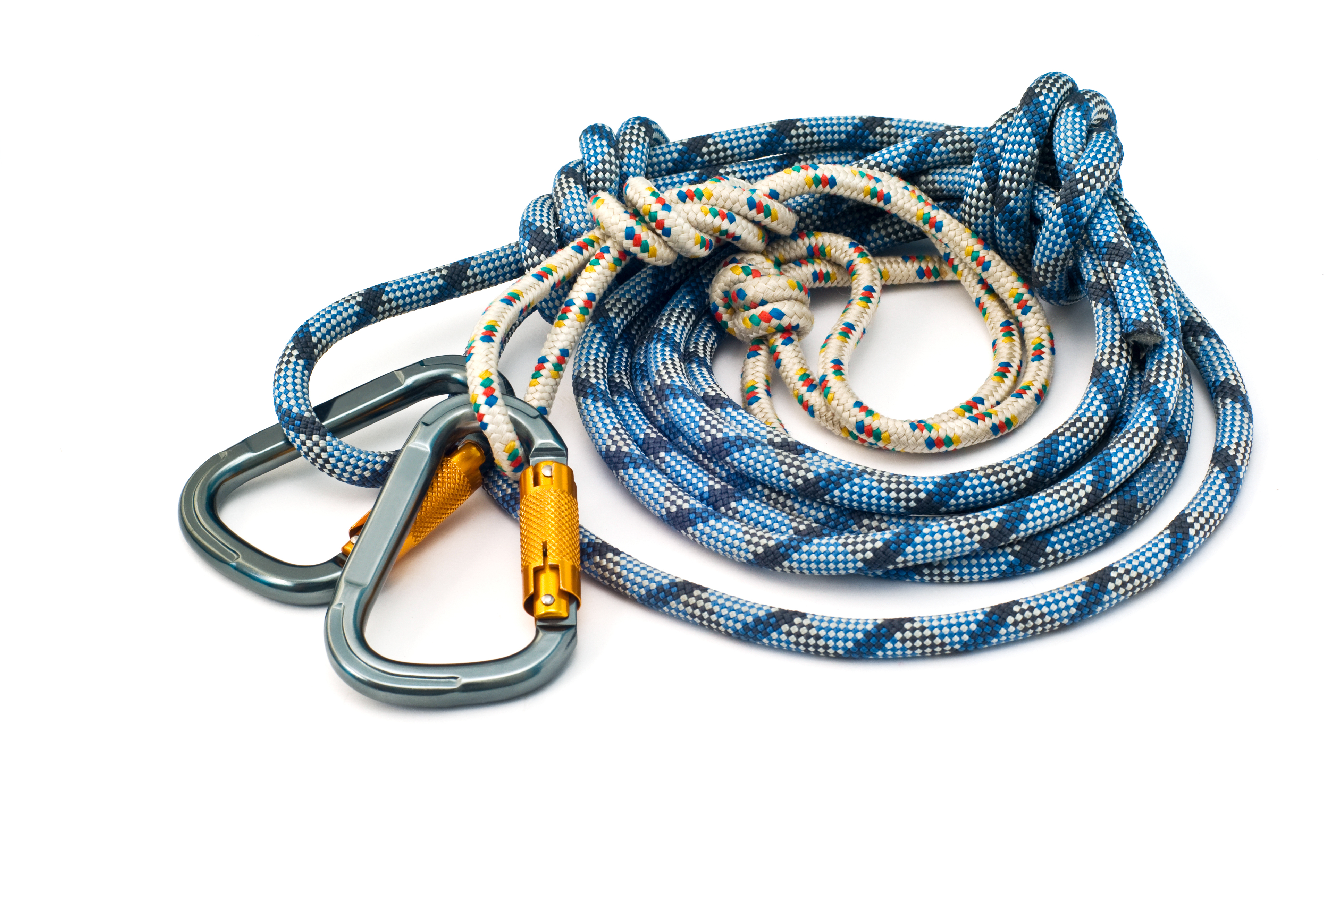
Campaign objectives
Raise awareness of the value of appointing a licensed insolvency practitioner (and especially an ICAEW IP)
Encourage businesses to seek professional advice early enough to give them options
Change perceptions about insolvency – reposition as business recovery
Notes:
The research findings you're about to see form part of a far broader campaign being undertaken by ICAEW.
The campaign objectives that were established have led to a very broad agenda of activity about raising the awareness of issues around insolvency and business recovery.
Let me take you through just some of the survey highlights. I'll be focusing on the broader issues facing the profession. The full survey report is available on ICAEW's website.

Slide 3



Respondent overview
55%
Describe themselves as an ICAEW licensed insolvency practitioner; 40% as an ICAEW Chartered Accountant
85%
Have over 11 years restructuring/ insolvency experience
Q1. Which of the following most closely describe you? (base: 146)
Q2. How many years’ experience do you have in restructuring / insolvency? (base: 145)
Q3. Which description best represents the firm / company you work for? (base: 146)
Notes:
The survey was sent to over 1,400 members of ICAEW's Insolvency and Restructuring group between 31 May and 14 July.
Over 10% completed the survey - survey experts tell us the normal response rate is 3 - 5% so a good response
34% of those responding were in firms of 5 or fewer principals
48% of those responding were in firms of 20 or more principals

Slide 4
Services offered and self description
Services offered
Describe yourself
Full service firm, big four, global firm, legal, etc
Solicitor, fraud investigator, lawyer, etc
Q4. Which of the following services does your firm provide? (base: 146)
Q5. When working with clients, how would you mostly describe yourself? (base: 146)
Notes:
Here's an overview of the services offered by those responding, which is interesting in comparison to the aspects of growth I'll cover later. So not surprisingly perhaps
92% currently offer formal corporate insolvency
82% currently offer formal personal insolvency
And in terms of how our IPs describe themselves to others
just over a third describe themselves as an IP
and just over a fifth describe themselves as an IP and Chartered Accountant

Slide 5
Change in services offered over past two years
‘Net’ change
+49%
+45%
+42%
+25%
+21%
-6%
-31%
-43%
Q6. Over the last two years what changes have you seen in the services that you offer for (base: 91 to 140)
Notes:
We wanted to identify how our licensed IP's work has changed over the last two years, where they have seen growth, and in particular whether there has been any impact on formal insolvency appointments, before asking for their views on the future shape of their business.
The highlights are at the two extremes of the graph - with the increase in demand for financial advisory up by a net growth of 49% with a similar increase in helping to raise finance and operational advisory. At the same time those responding are reporting a significant decrease in the levels of both personal and corporate formal insolvency appointments.

Slide 6







Change in way firm operates
75%
Have changed the way they operate as a result of market changes*
Decreased headcount | Moved into a new sector
53% | 41%
Q8. As a result of the market changes in the last two years, have you/ your firm changed the way you operate? (base: 146)
Q9. How have you changed the way your firm operates? (base: 109)
* Actual percentage is 75.34%
Notes:
ICAEW firms operating in this sector have clearly reacted to this shift - from headcount to sectoral movement. Picking on just a few highlights
53% have decreased headcount - conversely 22% have increased headcount
41% have moved into a new sector
And a number have or are developing new partnerships or acquiring a new business

Slide 7
Predicted change in services offered in future
‘Net’ change
+63%
+60%
+58%
+53%
+50%
+32%
+30%
+8%
Q10. Looking forward, over the next two years, what changes do you expect to see in the level of work for each of the following areas? (base: 107 to 136)
Notes:
If we now look forward at how firms see the next two years developing we're seeing that firms predict that the level of work in financial and operational advisory will continue, and so too will other advisory services such as raising finance, business planning and creditor liaison.
A key aspect for IPs and their firms is that they need to ensure that they are actively promoting these aspects of their services.
But it is worth pointing out that formal work is also predicted to see a significant net gain - especially in the corporate sector.
In order to understand what might be driving these forecasted developments we dug a little deeper into IPs views.

Slide 8
Predicted change in services offered in future (increase)
Formal corporate insolvency appts | 29%
Financial advisory | 19%
Helping to raise finance | 10%
Q11. In which area do you expect to see the most significant increase in the next two years? (base: 144)
Notes:
When asked about the most significant increase over the next two years is it surprising that formal corporate insolvency appointments have leapt to the top ?
In order to understand what might be driving these forecasted developments we wanted to dig a little deeper into IPs views on what external factors come into play in their thinking.

Slide 9
Driving future change
Impact of Brexit | 73%
Rise in interest rates | 56%
Attitude of HMRC/ banks as creditors | 43%
Q12. What do you think will be the top three reasons driving changes over the next two years? (base: 146)
Notes:
If the earlier slides were a representation of the changing shape of the sector, here’s a perspective on aspects that are seen as driving future change.
Continued uncertainty around the impact of Brexit and the implications of higher interest rates, unsurprisingly, loom large.
This is reinforced by the Q3, ICAEW Business Confidence Monitor, where the Confidence Index fell from 6.7 in Q2 to -8 in Q3. With input prices continuing to rise and the depreciation of Sterling failing to lead to faster growth in exports.
Attitudes, from the likes of HMRC as well as banks and creditors, towards the insolvency and business recovery sector also continue to have a major influence and are of concern to IP’s

Slide 10
Sectors facing increased financial difficulties
Retail | 77%
Care homes | 70%
Health-care | 44%
Q13. Over the next two years, what sectors do you think will face increased financial difficulty? (base: 145)
Notes:
When asked which sectors IPs identified as facing increasing financial difficulty retail and care homes led by some distance.
The table also reflects a number of other major sectors of our economy that IPs identify as under increasing threat. IPs raised concerns about
healthcare
education
agriculture
As well as the impact of debt on low income individuals and students.

Slide 11
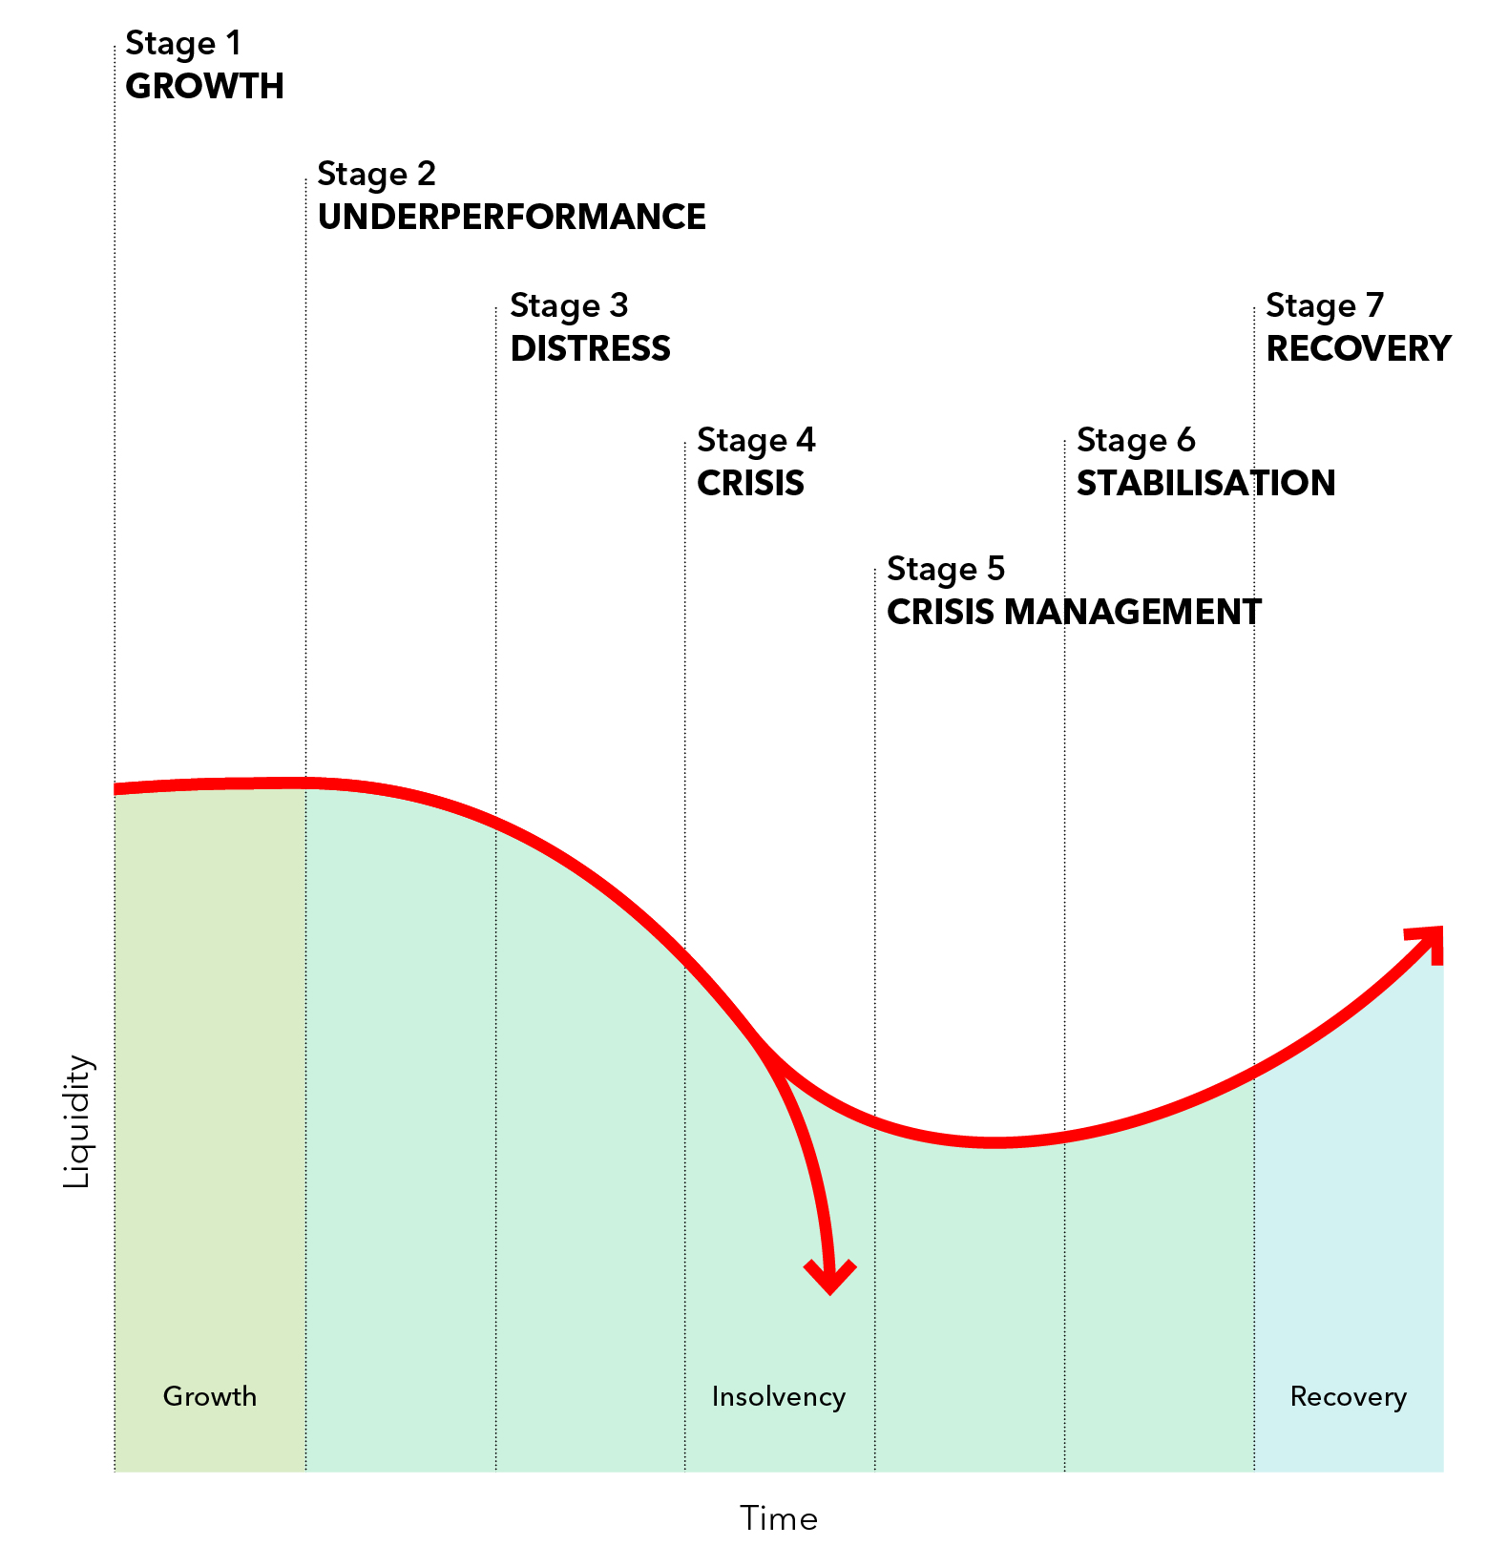
Decline and recovery curve
Notes:
At this point I’d like to introduce the decline and recovery curve – this may be familiar to many of you. We’ve been using this in our campaign to help to illustrate the need for businesses to identify the early signs of trouble and distress, so they can seek the correct specialist advice at the right time, so that the business has a far greater chance of recovery when there are more options available.
So, it is important we understand the human challenges, of giving the owners/directors more confidence to seek advice at this early stage and to dispel the stigma (and some myths) surrounding insolvency, and to raise awareness of the number of options that are open to them.

Slide 12
Reasons preventing companies seeking advice earlier
Worry about loss of control in the final outcome | 57%
Lack of knowledge of options | 52%
Fear of impact on family and lifestyle | 41%
Concern over costs | 41%
Q16. What do you think are the top three reasons preventing companies/individuals from seeking professional advice earlier? (base: 145)
Notes:
So why don't owners and directors of a company seek advice earlier ?
Those responding clearly identified the very human concerns over loss of control and impact on family, as much as the more quantifiable and actionable aspects of cost or knowledge - not that they are not all related!
And you can see the stigma of insolvency features as does not knowing where to go for advice. A major part of this campaign is to promote the valuable work that IPs ( and specifically ICAEW licensed IPs ) do by encouraging those in difficulty to seek advice early.

Slide 13







Healthy business rescue culture in the UK?
To what extent do you agree that there is a healthy business rescue culture in the UK?
16% | 38% | 38%
I don't think there is a business rescue culture in the UK | I believe there is an emerging business rescue culture in the UK | I agree there is a strong business rescue culture in the UK
Q18. To what extent do you agree that there is a healthy business rescue culture in the UK? (base: 141, 8% unsure)
Notes:
We also asked IPs if they thought the UK had a healthy business rescue culture. And the response was largely favourable with over 75% believing it was strong or emerging. But with only 38% believing that there is a strong business rescue culture there is clearly more that we and government need to do in this regard.

Slide 14
Summary of findings
Changing shape of IP business
Upcoming growth expectations
Drivers of change
Sector vulnerability
Concerns over insolvency
Business recue culture in the UK
Notes:
So in summary the survey told us:
The last two years have seen a change in the shape of IP’s business and workload, with an increase in financial advisory, raising finance and operational advisory. But a decrease in levels of both personal and corporate formal insolvency appointments
Looking forward, areas of advisory and finance raising are expected to continue to grow. However, more formal appointments are also expected to see a net gain – especially in the corporate sector
Key drivers of this change are seen to be the impact of Brexit, the likely increases in interest rates as well as longstanding issues around the actions and attitudes of HMRC, banks and other creditors
Retail and care homes are identified as particularly vulnerable
Company owners/directors concerns over loss of control and the impact on family and lifestyle as well as lack of knowledge of options prevent companies seeking advice earlier – when more options would be available
And that while there is generally a positive and improving view in the UK towards a business rescue culture, there is still plenty of work to do

Slide 15
Next steps with the research
Media
Public affairs
Sharing with firms to use findings
Social media
Future development
Notes:
We now want to maximise the value of this research. We have started using it in a number of ways:
two alternate press releases were issued at the beginning of September targeted at different sectors. One looking at the business environment and areas of increasing risk impacting the insolvency market - such as Brexit. The other focused on the business rescue culture and the challenges facing British business.
we will be seeking to weave learning from the feedback into the broader public affairs agenda as we engage with government and key business community stakeholders
we've shared the findings with R3 to ensure our joint efforts are coordinated for the good of the profession
ICAEW staff are using the key facts and figures from the campaign on social media
and finally the findings are now being played out at ICAEW events such as these roadshows. We are encouraging you to quote highlights from the research as you engage with clients and professional contacts. The survey and these slides and speaking notes are available on our website at icaew.com/promotingIPs

Slide 16
Always use an ICAEW licensed insolvency practitioner (UK)
FOR MORE INFORMATION VISIT ICAEW.COM/INSOLVENCY
Notes:
In the next session you will hear much more about the campaign to promote the value of ICAEW licensed IPs but for now I will leave you with our key message.
‘’Always use an ICAEW licensed IP’’

