Slide 1
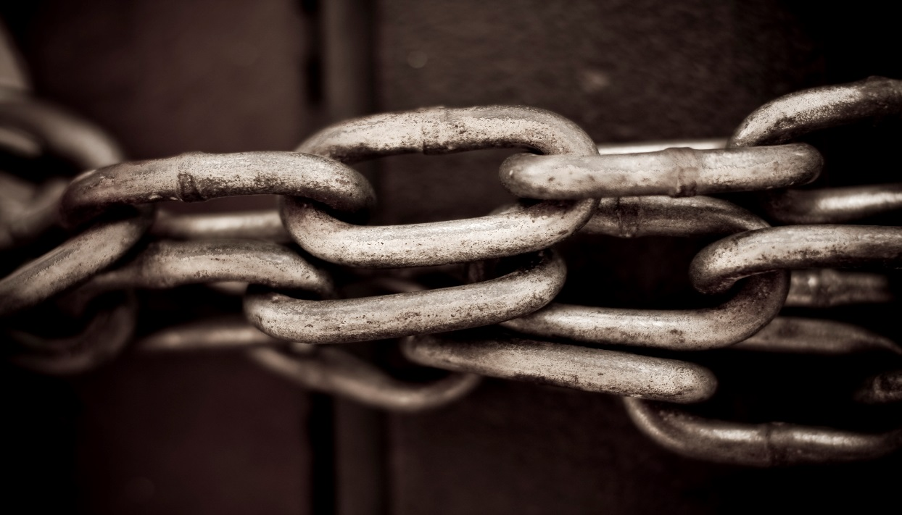
The Modern Slavery Act 2015
It doesn’t affect my organisation or does it?

Slide 2

The Modern Slavery Act 2015
It doesn’t affect my organisation or does it?
Chair’s Opening Remarks – Francesca Sharp

Slide 3

The Modern Slavery Act 2015. It doesn’t affect my organisation or does it?
  Content
  1. Chair’s Opening Comments
  2. The Modern Slavery Act 2015
  3. Guidance for ICAEW members
  4. Further Information
  4. Q and A

Slide 4


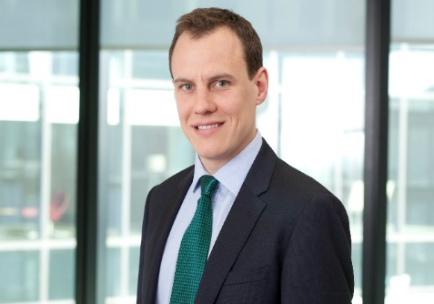
Presenters
Francesca Sharp – ICAEW
Sustainability
Jane Berney FCA – ICAEW
Business Law
Patrick Shaw-Brown - PwC
Sustainability and Climate Change
Notes:
Jane joined ICAEW's Technical Directorate in November 2013 as a Business Law Manager. Jane is responsible for business law and regulatory requirements not dealt with elsewhere at ICAEW. The Business Law Department lobbies for changes in areas of the law and regulation which are relevant to accountants and the accountancy profession. It also contributes, where possible, to proposed changes in the law and provides guidance on the outcomes. Guidance is issued formally in technical releases or in the regulations standards and guidance, or informally through articles in ICAEW magazines, newsletters or elsewhere.
Before joining ICAEW, Jane worked as an audit manager for EY and KPMG in London, Amsterdam and Cambridge.
Patrick works in the Consulting division of PwC, leading the firm's work on human rights. His work led to PwC being named as a key contributor in the Home Office’s ‘Practical Guide’ for companies and he has worked with numerous clients (of varying sizes and from a range of sectors) on the Act over the last year."

Slide 5

The Modern Slavery Act 2015
Jane Berney

Slide 6
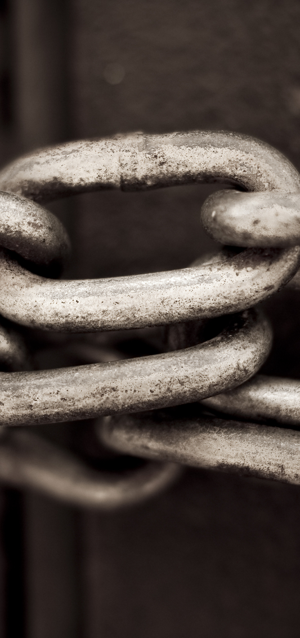
The Modern Slavery Act 2015
Contents
What is slavery – past and present?
Purpose and Main Features of the Act
Definitions of ‘Modern Slavery’ in the Act
Implications for businesses & organisations
Section 54 – ‘Transparency in Supply Chains’ Statement
      Who, what, where, how and when?
Consequences for businesses and organisations
Notes:
Good afternoon
In this section of the webinar I shall be looking at the UK’s Modern Slavery Act and why this piece of legislation, which many might assume to be more of an act designed to prevent a social evil rather than a financial crime, has the potential to apply to very many ICAEW members.
So I shall begin with a brief précis of the Act itself and then focus on what is the arguably one of the most controversial sections of the Act but the one that is likely to impact on ICAEW members whether in practice or business – that is section 54 and the ‘Transparency in Supply Chains ‘ statements

Slide 7
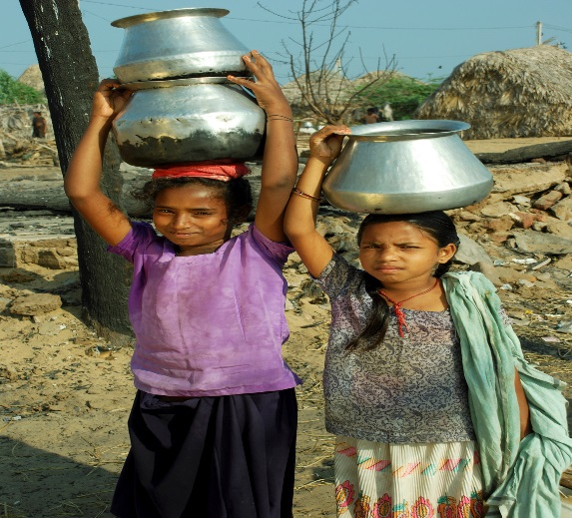
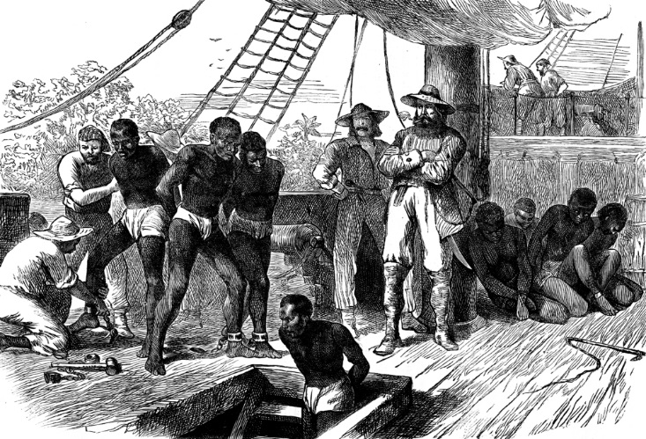
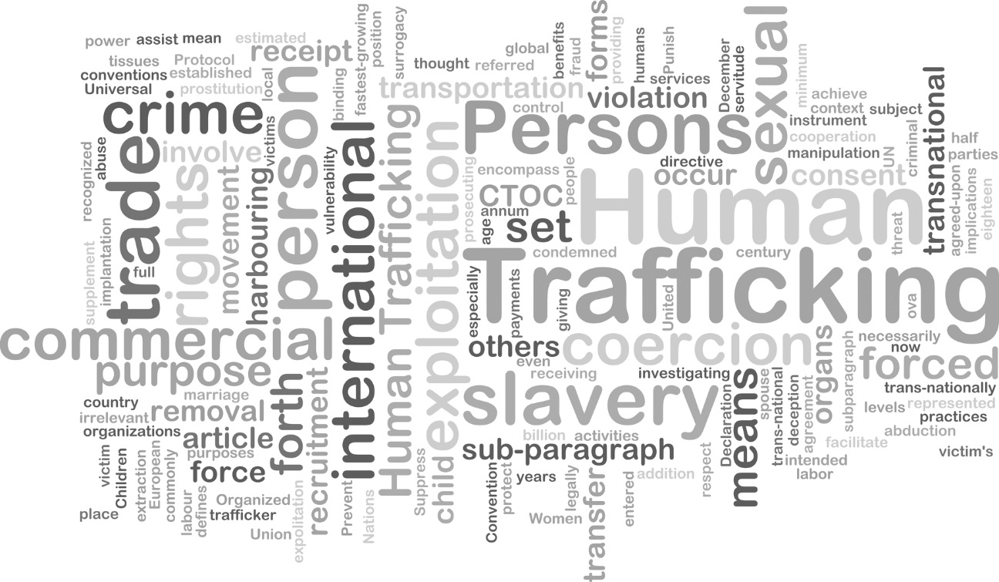
What is slavery?
Notes:
SHOW FIRST PICTURE
I think there is a tendency to assume that slavery is either something that belongs to the past
OR SHOW SECOND PICTURE
something that is a problem in poor third world countries and primarily involves children, forced to work long hours in unsafe conditions. Or sex workers (but I haven’t got a picture of that!)
But the reality is quite different
SHOW THIRD PICTURE
This graphic is supposed to represent the main forms of slavery that exist today.
Recent estimates suggest that in 2014 there were something like 13,000 slaves in the UK and some 36 million across the world. As this graphic suggest it is not enough for us to be concerned or even aware of the human suffering but we also need to understand the different types and varying degrees of slavery, the links to crime, particularly with regard to trafficking but not solely so and the sheer pervasiveness of modern slavery in certain industries and geographical regions. Not withstanding this we also need to remember that it is very much part of the ‘modern’ world hence the reference to ‘modern slavery’
The Home Sec – Teresa May- described modern slavery as ‘a heinous crime that affects communities and individuals across the globe. Moreover she noted that ‘ it is all around us. It is walking our streets, supplying shops and supermarkets, working in fields, factories or nail bars, trapped in brothels or cowering behind the curtains in an ordinary streets.’
The point being that slavery did not end in the UK or indeed the world with the abolition of slavery in the British Empire nearly 200 years ago .So although illegal it has continued albeit in different guises but with the same cost in terms of human suffering and loss of dignity. GO TO NEXT SLIDE

Slide 8
The Modern Slavery Act 2015
Purpose of the Act
Main features
Definition of Slavery in the Act
Implications for businesses and commercial organisations
Jurisdiction
Notes:
The purpose of the Modern Slavery Act 2015, therefore , was to consolidate previous UK legislation on slavery, child labour and human trafficking offences. It became law on October 29 2015.
It defines slavery , which includes servitude, forced and compulsory labour , as existing where ‘a person‘ holds ‘another person in slavery or servitude or forcing another person to undertake compulsory labour , where the person knows or ought to know that the other person is being held in slavery or servitude or the person knows or ought to know that the other person is being forced to perform compulsory labour.’ This is a very wide definition but the key is whether there exists an element of coercion. So if the person or employee can leave easily and without threat to themselves or their family, then irrespective of whether they receive poor wages or work I an unsafe environment, or for long hours then it would not constitute slavery, servitude or forced and compulsory labour. Although you might be breaking other laws re: minimum wage, health and safety etc. The definition also means you cannot turn a blind eye to what is going on –so very similar to the UK’s Bribery Act in this respect.
The Act also introduced a new Anti- Slavery Commissioner and new measures to protect the victims and stiffer penalties include life imprisonment for traffickers or slave owners and reparation of assets.
As regards Jurisdiction – offence of slavery only applies if committed in England and Wales, but the offence of human trafficking for a UK national can be committed in any part of the world or for a non-UK national if occurs in the UK.
But what is new and in fact is a first in Europe (although there is something similar in California) was the responsibility it placed on commercial organisations to take an active part in stopping slavery and trafficking. And this is not limited to an organisation’s UK operations but anywhere in the world. Nor is it limited to UK organisations but to anyone who carries on part of a business (including a trade or profession) in any part of the UK. This is the reporting requirement introduced by section 54 of the Act.
GO TO NEXT SLIDE

Slide 9
The Modern Slavery Act – Section 54
Transparency in Supply Chains statement
      What is it?
Who has to prepare one?
      Body corporate or partnership
      Carries on a (or part of a )business in UK
      Supplies goods or services
      If turnover exceeds £36million
When?
      Annually
      Year ends on or after 31 March 2016
      Within 6 months of year end - recommended
Where?
      Prominently on website – homepage
Notes:
Section 54 states that ‘ a commercial organisation … must prepare a slavery and human trafficking statement for each financial year.’
So who does this apply to ?
Any commercial organisation that supplies goods and services, with an annual turnover that exceeds £36 million and that carries on its business (that is trade or profession) or part of its business in the UK is covered by section 54. Thus body corporates, partnerships and group companies, including those with a non-UK based parent fall within the remit of the Act. An organisation can chose whether to produce a statement for each entity that meets the criteria or one for the organisation in its entirety. If the latter is chosen the statement must reflect the steps taken in all parts of the organisation.
The only exemption relates to turnover and only applies if turnover exceeds £36m. Turnover is defined as the amount derived from the provision of goods and services as part of the ordinary activities of the organisation. The idea of linking the statement to turnover, rather than any other size indicator such as employees or number of sites etc, was that it would apply to those companies and organisations who have the purchasing power to take and enforce action to combat slavery.
A word of warning - Even if an organisation does not meet the criteria, it is likely that it will need to provide this information to its suppliers or customers who do meet the criteria.
So when do the requirements start?
The first organisations that the new requirement will apply to will be those with a year ending on or after 31 March 2016 and their statements should report on the steps taken during their 2015/16 financial year. Thereafter the statement should be produced annually and within 6 months of the financial year.
If an organisation meets the criteria for one year it is expected that in future years it will continue to produce a statement and therefore continue to take steps to prevent slavery and human trafficking in its business.
Where?
The statement does not have to be part of the published financial statements but does have to be published on an organisation’s website and a link must be prominently displayed on the organisation’s homepage. A suggested link is ‘Modern Slavery Act Transparency Statement.’

Slide 10
The Modern Slavery Act – Section 54
Can I opt out?
      ‘Nil’ Return – still must be public
Consequences
      Reputation
      Possible disbarment from public contracts
      Injunction/Contempt of Court/Unlimited Fine
Notes:
An organisation can say that it has taken no steps but if it meets all the criteria set out in the Act then it must publish on its website a statement to that effect.
Consequences
The most immediate consequence of non – compliance is expected to be loss of reputation and the knock on effect this may have on the sales and business.
BUT just in case this doesn’t work -
If an organisation does not prepare a statement, the Secretary of State can apply for an injunction to force compliance. If an organisation still refuses to comply they will be deemed to be in contempt of a court order, which is punishable by an unlimited fine.
It is expected, however, that this will be a last resort. Rather it is expected that pressure from consumers, investors and non-governmental organisations as well as the potential threat to their reputation will encourage organisations to comply with the Act.
So if section 54 applies to your organisation what do you have to do?
In some respects it is quite simple you have to prepare a ‘Transparency in Supply Chains‘ statement . But what is this?
GO TO NEXT SLIDE

Slide 11
Transparency in Supply Chains Statements 1
No prescriptive guidance but ‘may’ include details of the following:
        The organisation’s structure, business and supply chains
        Policies on slavery and human trafficking
        Due diligence processes re: slavery & human trafficking
        Where in the business/supply chain there is a risk of slavery & human trafficking
        How does it assess /manage risk /ensure not taking place?
        Staff training
The above is not an exhaustive list
Not compulsory to include all of the above –must reflect actual steps taken
Can be an ‘evolving’ document
Can include future steps
Notes:
The govt believes that organisations need to be upfront about what they are doing and so the legislation says they must produce a statement detailing this. But the guidance issued by the government is deliberately non –prescriptive but it does suggest the following’ may’ and I stress ‘may’ not ‘must’ be included
READ FROM SLIDE – 6 points .
As it says this is not an exhaustive list and it’s not compulsory to include all of them
The key is that it must state what you are doing and not just that you have a policy. The reasoning is that everyone , I assume, would say that their policy is not to tolerate slavery but the government wants organisations to be far more proactive and so the statement must state what you are actually doing. The idea is that if you know the risk the you can take steps to avoid it but if you don’t that know that there is a risk then you can’t.
The government wants companies to adopt a common sense approach and argues that these are the sort of things organisations should be considering. It should not be a burden. Their impact assessment has suggested that it will take the average company 3 days to prepare at a cost of about £700. Whether or not this is realistic , I don’t know but, for example you should perform a risk assessment on all suppliers anyway, so this is just an extension to normal practice . But by considering slavery in this assessment it also means an organisation can consider whether the policies currently adopted could actually encourage slavery. For example by imposing tight cost margins or tight deadlines on suppliers are you actually encouraging them to consider slavery or forced labour as the only way to meet your demands.
Again staff training (and then should include agents and not just those directly employed by you) should be routine and this can be linked to training on the UK Bribery Act and Whistleblowing. By encouraging the latter you can ensure that staff are not afraid to speak up if they suspect slavery
As it says on the slide the document can be evolving – this is a recognition that what you do may change over time. It can also include the steps you intend to take , though the expectation is that future statements would show whether you have done this and if not why not.

Slide 12
Transparency in Supply Chains Statements 2
Other points to note:
Approval by director/senior management
Publicly available eg link on website
Succinct but clear – can include links
Not a guarantee that slavery does not exist
Notes:
The guidance does not say who should prepare the statement, though I would suggest that it would be a team effort and involve contributions from different sections within the organisation.
BUT whatever the complexity or otherwise of the statement it must be approved by a senior member of the organisation’s governing body – so by a director or senior partner. The idea of this is not to make the approver directly liable but to ensure that there is top-level commitment to eradicate slavery. This is essential.
As I've mentioned before it needs to be publicly available but it also needs to be succinct and clear which is why the guidance suggest that the statement can include links to policy documents or other supporting documentation.
Finally it is not a guarantee that there is no slavery but it is meant to represent a commitment to eradicate such a heinous crime as slavery and remember it is a crime.

Slide 13
Transparency in Supply Chains Statements 3
Non- qualifying organisations
      May be asked to confirm what they have done by suppliers and/or customers
      Reputational Risk
Future Changes to the Law
Monitoring
Notes:
If you do not qualify you may still have to provide information to your suppliers or customers and the govt would like to encourage non- qualifying companies to comply. This is because eliminating slavery is not achievable by one company alone so it will take a concerted effort.
A word of warning - If you are unable to supply the relevant information when asked you may find that your supplier or customer may decide not to trade with you in future because it means they can’t comply with the legislation or they may name and shame you in their statement. So your reputation could suffer. I don’t think the govt intends to threaten non- qualifying companies to comply but they believe that all organisations should want to comply because it is the right thing to do. They also believe that trying to eradicate slavery will ultimately be good for commercial organisations. It is perhaps worth remembering here that the abolition of slavery in the C19th in the UK was finally agreed by parliament when the abolitionists pointed out that the slave system was not profitable for the plantation owners!
Future changes - when the act was originally discussed , many wanted the statement to be included in the financial statements. This was dropped in the end but many groups are pressing for this to be added to the legislation and a bill has been prosed in the Lords , although it is unlikely to get anywhere fast at the moment.
Finally a word about monitoring – this is largely by voluntary organisations and pressure groups, not the government, though latter does have power to review section 54 every 5 years.
. In the slide on further information I've include a link to the CORE Coalition and the Business and Human Rights Resource Centre who have set up a central registry holding all the statements published to date and with a commentary as to whether they fully meet the requirements . The most common omission to date seems to be sign of by a senior member of the management r governing team.

Slide 14
Thank You
Notes:
So Ito conclude the Modern Slavery Act does apply to all organisations through the section 54 statements and so many ICAEW members whether in business or practice may find that they have to prepare or approve one. I will now hand over to Patrick., but will be back to answer questions at the end of the session.

Slide 15
The Modern Slavery Act 2015
Q and A
Notes:
We will be taking questions at the end of the session but you can post them throughout the session.

Slide 16
The Modern Slavery Act 2015
Guidance for ICAEW members
Patrick Shaw- Brown – PwC

Slide 17
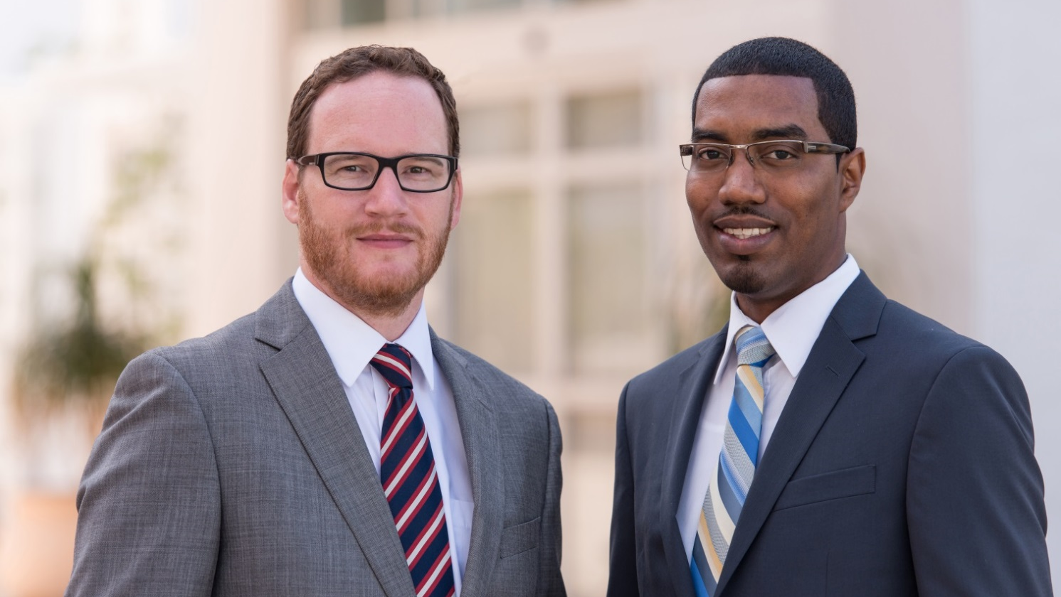
Guidance for ICAEW members
www.pwc.co.uk
The Modern Slavery Act
June 2016

Slide 18
Market responses to the statement
Companies with complex group structures are having to decide which group entities to cover in
their Statement.
Some companies are responding to stakeholder pressure by releasing interim statements.
Where companies have more than one website, they are generally using the corporate site, despite
the Guidance.
The production of the Statement is managed by a range of teams: Ethics, Compliance, Legal, Sustainability, HR and/
or Procurement.
MSA Statements are designed to be updated on an annual basis. The first statement therefore may focus on what will be done, rather than what has been done.
The statements released so far vary in length. The most thorough touch on each of the 6 areas laid out in the ‘Practical Guide’ but coverage has
been patchy.

Slide 19
Training is generally well covered but disclosure on risk assessments and performance is poor
Business organisation, structure and
supply chains
Policies
Due diligence
1
2
3
Risk assessment
Performance
Training
4
5
6
Source: PwC analysis

Slide 20
What are companies doing to respond to the Act?
New internal reporting frameworks
Evaluation of
existing KPIs
External reporting
Policy
Assigned responsibilities
Communication of governance arrangements
Monitoring
and reporting
Governance
Training of own employees
Training of suppliers’ staff
High-level risk assessment
Risk validation
Stakeholder engagement
A comprehensive approach to modern
slavery risks
Risk assessment
Embedding: Training
Embedding: Grievance and remediation
Embedding:
Due diligence
Grievance mechanisms
Remediation processes
Communication to stakeholders
Supplier contracts
Audit strategy and protocols
Engagement with, and standards for, suppliers

Slide 21
What are companies doing to respond to the Act?
New internal reporting frameworks
Evaluation of
existing KPIs
External reporting
Policy
Assigned responsibilities
Communication of governance arrangements
Monitoring
and reporting
Governance
Training of own employees
Training of suppliers’ staff
High-level risk assessment
Risk validation
Stakeholder engagement
A comprehensive approach to modern
slavery risks
Risk assessment
Embedding: Training
Embedding: Grievance and remediation
Embedding:
Due diligence
Grievance mechanisms
Remediation processes
Communication to stakeholders
Supplier contracts
Audit strategy and protocols
Engagement with, and standards for, suppliers

Slide 22
Supplier due diligence
Contractual conditions
Review of statement/policies
Internet ‘scraping’
Building on existing process
e.g. the UK Bribery Act
Audits
Capacity building

Slide 23
The Modern Slavery Act as a catalyst for broader progress
Sustainability: All parts of the sustainability agenda including environmental and business ethics issues.
Social issues: The full breadth of social issues including impacts like employee engagement and community development.
Human rights: All 32 of the recognised human rights such as right to privacy and right to education.
Labour rights: All of the key internationally-recognised labour rights issues i.e. child labour, unionisation and discrimination, in addition to slavery.
Modern slavery: The specific issue of slavery, which can be broken down into human trafficking, forced labour and debt bondage.

Slide 24


Thank you
For more details, please contact:
Patrick Shaw-Brown
T: +44 (0) 20 7212 1353
E: patrick.j.shaw-brown@uk.pwc.com

Slide 25
This publication has been prepared for general guidance on matters of interest only, and does not constitute professional advice. You should not act upon the information contained in this publication without obtaining specific professional advice. No representation or warranty (express or implied) is given as to the accuracy or completeness of the information contained in this publication, and, to the extent permitted by law, PwC does not accept or assume any liability, responsibility or duty of care for any consequences of you or anyone else acting, or refraining to act, in reliance on the information contained in this publication or for any decision based on it.
© 2016 PwC. All rights reserved. “PwC” refers to the PwC network and/or one or more of its member firms, each of which is a separate legal entity. Please see www.pwc.com/structure for further details.
160622-174110-PS-OS

Slide 26
Further Information
ICAEW
      Modern slavery webpage with more guidance and links
PWC
      ‘Responsible Business. What are companies doing to respond to The Modern Slavery Act?’ Report published Summer 2016
Government Publications
      ‘Transparency in Supply Chains etc. A practical Guide’ Home Office Publications
      ‘The Modern Slavery Act 2015’ available from legislation.gov.uk
      ‘The Modern Slavery Act 2015 (Transparency in Supply Chains) Regulations 2015’ available from legislation.gov.uk
      ‘Stopping Modern Slavery in Business’ Home office video
Other Sources
  ‘Beyond Compliance: Effective Reporting under the Modern Slavery Act’ CORE Coalition publication Feb 2016
  Register of slavery & human trafficking statements, CORE publication March 2016, analysis of statements published so far
Notes:
There are also lots of other publications from various charities and NGOs such as the UN, Transparency International and Global Witness who can provide examples of instances of slavery and how to spot them.

Slide 27
The Modern Slavery Act 2015. It doesn’t affect my organisation or does it?
Q and A
Notes:
Suggested questions
What do I do if I suspect slavery or finds slavery?
How can I be expected to find slavery in my foreign operations, or foreign suppliers or customers?
What is the liability of the Director or Senior Ptr etc who signs off the statement?
Won’t this involve an awful lot of work ?
My organisation does not have foreign suppliers, customers and does not operate in any of the obvious areas – do I really need to worry about this?
What about franchises?
What about agents?
Overseas subsidiaries?
What if my turnover is £37m one year and £35m the next – due I still have to produce a statement in the second year?

