Slide 1
Session 2: Building Core Drivers
EXCEL LUNCH & LEARN · FUNDAMENTALS OF 3-WAY FINANCIAL MODELLING
Revenue, operating costs, fixed assets, debtors and creditors
With live Excel walkthroughs
John Yeldham · Ruth Butler-Lee · Ben Ducker
Notes:
Welcome and introductions (about 2 minutes). Then straight into the recap.

Slide 2
The skeleton from Session 1
01 · RECAP
Financial statements
Sheets
Timeline
P&L, balance sheet and cash flow, laid out and balancing
Inputs, calculations and outputs, each in their place
One timeline, referenced everywhere
Excel Lunch & Learn · Session 2: Building Core Drivers
Notes:
What we built in Session 1: the financial statement structure, the model sheets (inputs, calculations, outputs) and the timeline. Today we hang the core drivers on this skeleton.

Slide 3
Sign convention
01 · RECAP
Inputs
Calculations
P&L
Cash flow
Balance sheet
+
+
+
+
Income
+
−
−
−
Costs
+
+
−
+
Assets
+
+
Liabilities
No single right answer, but every model needs a clear one
Excel Lunch & Learn · Session 2: Building Core Drivers
Notes:
Signs need attention. The model's convention is fairly non-standard, which proves the point: always check how a model handles signs. The matrix shows the system used in our model.

Slide 4
What this session adds
01 · SESSION OBJECTIVES
01
02
03
Revenue and operating costs
Fixed assets
Trade debtors and creditors
Driver-based blocks
Corkscrew accounts
Working capital and cash
Live Excel walkthrough with Ruth
Live Excel walkthrough with Ruth
Live Excel walkthrough with Ruth
Excel Lunch & Learn · Session 2: Building Core Drivers
Notes:
Quick recap of the skeleton from Session 1, then what this session adds. Revenue and operating costs: driver-based blocks. Fixed assets: corkscrew accounts. Trade debtors and creditors: working capital and cash. Ruth walks through revenue and costs, builds fixed assets live, and walks through debtors and creditors.

Slide 5
From sessions 1: build once, copy across
01 · RECAP
One formula per row
Reference the current column
Written once, copied across every period
Each period reads its own column
ƒ
ƒ
ƒ
ƒ
ƒ
ƒ
Revenue
Excel Lunch & Learn · Session 2: Building Core Drivers
Notes:
Establishing the discipline of consistent rows, and formulas that reference the current column.

Slide 6
Techniques from session 1
01 · RECAP
Styles
Checks
Colour coding shows cell purpose at a glance
Robust check formulas
Every check reports to one central check sheet
We will use both again today
Excel Lunch & Learn · Session 2: Building Core Drivers
Notes:
Two things from Session 1 we will keep using: styles and checks. What they looked like, and where they will turn up again today.

Slide 7
Driver-based revenue
01 · REVENUE AND OPERATING COSTS
Parameters
P1
P2
P3
P4
P5
Variable
Volume driver
Moves with a driver, such as volume
Price
Variable revenue
Fixed revenue
Fixed
Total revenue
A set amount each period
↑ Left-hand column holds the parameters
In our model: course revenue is variable (courses run × revenue per course), and merchandise is fixed per year
Excel Lunch & Learn · Session 2: Building Core Drivers
Notes:
Key revenue drivers and how they link into the output statement. Driver-based approach generalises across business models (e.g. SaaS, manufacturing) even though the worked example uses one. Simple block structure. Left-hand column parameters. Variable versus fixed revenue: course revenue is courses run times revenue per course (both CPI-inflated); merchandise is a fixed £30k a year. Courses run can be calculated from staff capacity or fixed, via the course calc switch.

Slide 8
Same principle for operating costs
01 · REVENUE AND OPERATING COSTS
Variable
Fixed
Moves with a driver, such as volume or activity
A set amount each period
In our model: venue costs per course are variable, marketing is fixed per year, and staff costs follow headcount
Excel Lunch & Learn · Session 2: Building Core Drivers
Notes:
Same linking principle as revenue, applied to operating costs, with the same fixed versus variable split. In the model: venue costs per course (variable), marketing per year (fixed), staff wages and expenses driven by the number of employees.

Slide 9
From revenue and op costs to cash via profit and loss
01 · REVENUE AND OPERATING COSTS
Revenue
Op costs
P&L
EBITDA
Cash flow
→
→
→
Cash flow starts at EBITDA in our example
So the double entry with cash is automatic
Other routes work too, such as reporting revenue and costs directly in the cash flow statement
Each line is tagged with the statement it feeds
In our model: revenue and operating costs carry a PL tag
Excel Lunch & Learn · Session 2: Building Core Drivers
Notes:
Update the P&L in the financial statements. The cash flow starts at EBITDA, so the double entry with cash is automatic. The agreed indirect cash flow is already in the model. Revenue and operating costs follow the same route. Statement tagging: each calculation line carries a tag (PL, CF or BS) for the statement it feeds; revenue and operating costs are tagged PL.

Slide 10
Over to Ruth
LIVE EXCEL WALKTHROUGH
Revenue and operating costs
Notes:
Ruth: revenue build walkthrough, then operating cost build walkthrough.

Slide 11
Fixed assets
02
Built live, from scratch
Notes:
Fixed assets is the opportunity to explain a corkscrew, or control account.

Slide 12
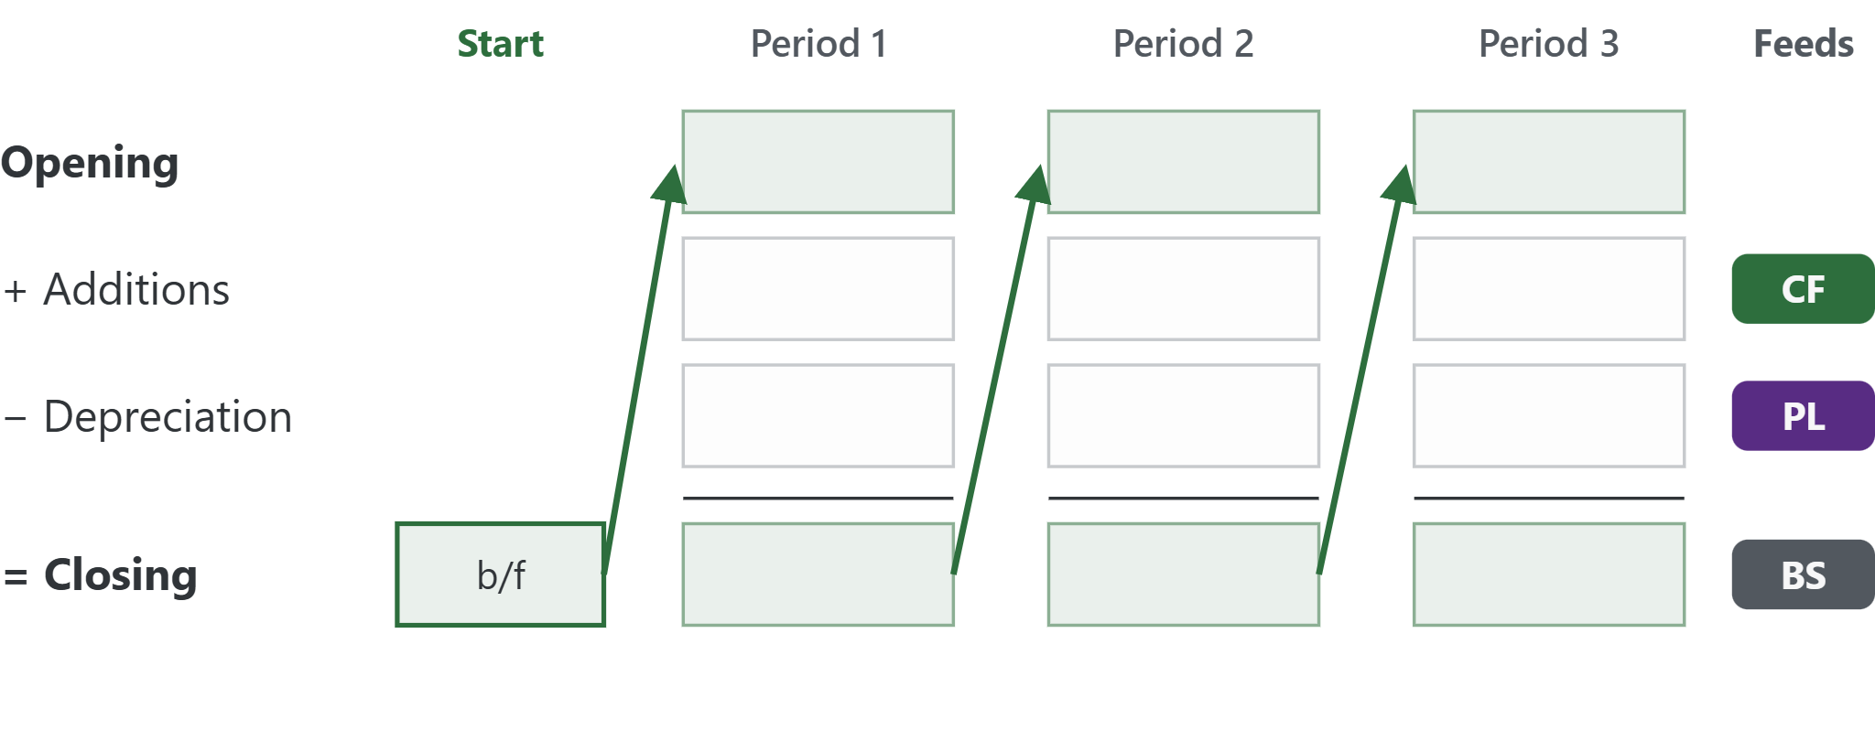
The roll-forward (corkscrew)
02 · FIXED ASSETS
Reusable
Returns for debt in Session 3
Opening balance
Its own column, before the timeline starts
Opening + additions − depreciation = closing
Excel Lunch & Learn · Session 2: Building Core Drivers
Notes:
Name the roll-forward as a reusable technique: it resurfaces for debt in Session 3. Also called a corkscrew or control account. Closing balance becomes next period's opening balance. The opening balance sits in its own column before the timeline (column L in our model).

Slide 13
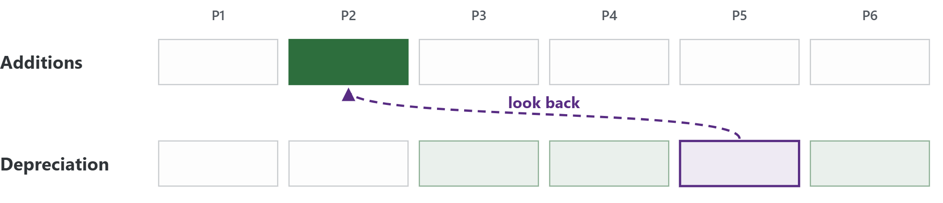
Looking back in time
02 · FIXED ASSETS
A look-up formula reaches back in time, to additions in this case
Excel Lunch & Learn · Session 2: Building Core Drivers
Notes:
Example of a look-up or formula to look back in time, to additions in this case.

Slide 14
Feeding all three statements
02 · FIXED ASSETS
Depreciation
→
P&L
Every calculation line
→
Additions
→
Cash flow
is tagged with the statement it feeds
Closing balance
→
Balance sheet
Excel Lunch & Learn · Session 2: Building Core Drivers
Notes:
Fixed assets feed all three statements: depreciation to the P&L, additions to the cash flow (as capex), and the closing balance to the balance sheet. In the model the roll-forward lines carry PL, CF and BS tags.

Slide 15
Over to Ruth
LIVE EXCEL WALKTHROUGH
Fixed assets
Notes:
Ruth: live build of the fixed assets roll-forward from scratch.

Slide 16
Trade debtors and creditors
03
Working capital and the indirect cash flow
Notes:
Principles of double entry for indirect cash flows.

Slide 17
Driver-based working capital
03 · WORKING CAPITAL
Parameters
P1
P2
P3
P4
P5
Revenue
Debtor days
Trade debtors
↑ Left-hand column holds the parameter
Debtor days
Trade debtors = Revenue ×
Days in period
Excel Lunch & Learn · Session 2: Building Core Drivers
Notes:
Trade debtors as a driver-based calculation: three lines. Revenue links from the revenue build, debtor days is a single parameter in the left-hand column, and the trade debtors balance (tagged BS) is revenue times debtor days over days in the period. Creditors work the same way, driven by costs and creditor days.

Slide 18
Balance movements are cash movements
03 · WORKING CAPITAL
Trade debtors
Trade creditors
↑ Debtors
→
↓ Cash
↑ Creditors
→
↑ Cash
Driven by revenue and debtor days
Driven by costs and creditor days
Feeds
Balance sheet: closing balances
Cash flow: movements
This is the indirect cash flow method
Excel Lunch & Learn · Session 2: Building Core Drivers
Notes:
Debtor days and creditor days as working-capital drivers. Linking revenue and costs to the balance sheet and cash flow. Principles of double entry for indirect cash flows. Working capital effect on cash.

Slide 19
Over to Ruth
LIVE EXCEL WALKTHROUGH
Trade debtors and creditors
Notes:
Ruth: trade debtors and creditors.

Slide 20
Any questions?
04
John Yeldham JogEye · Lodeum
Ruth Butler-Lee Arriva
Ben Ducker Modelling Expert Ltd
Notes:
Questions from the audience.

