Slide 1
Markers’ payment & payroll process

Slide 2
Welcome
ICAEW Shaun Robertson – Director, Education and Qualifications

Slide 3
ICAEW approach
ICAEW James Froggatt – Tax Manager

Slide 4
Employment Status History
Over the last 5 years, there has been a tightening of legislation, case law and HMRC attitudes in relation to intermediaries and off-payroll workers.
This included
New legislation on intermediaries (first in the public and from 1st April 2021 in the private sector)
New case law on employment status
New case law on tax relating to employment status
The emphasis has changed from contractors determining their own employment and tax status to the client determining the employment and tax status of the contractor

Slide 5
ICAEW Response
With the change of emphasis, there was a potential multi- million pound risk identified if ICAEW did not apply the correct employment status to all its contractors
To protect the ICAEW, a review was undertaken (starting in January 2020) of the employment status of all ICAEW intermediaries, contractors and off-payroll workers

Slide 6
ICAEW Decision
Employment law and the resulting tax treatment as a result of case law is very subjective so the decision with regard or Markers was a difficult one and not taken lightly with continuous consultation throughout the ICAEW.
Third party advice was sought from Altor Solicitors on Employment Law and Deloitte on tax aspects.
Finally on the balance of risk, considering all factors, it was decided that we could not expose the ICAEW to an HMRC audit resulting in financial and reputational loss.
Marker intermediaries will be treated mainly as Inside IR35 and put on an IR35 payroll
Markers directly employed by ICAEW will be treated as workers and put on a new Markers payroll

Slide 7
Markers Employment Law
Simon Whysall – Altor Employment Solicitors

Slide 8
Markers Employment Law
Under current employment law, there are three categories of individuals providing their services in the job market:
Employee
Worker
Self-employed independent contractor
There are statutory definitions for the first two categories, although these are not comprehensive and the current position has been substantially defined through case law. An individual who is neither an employee nor a worker will be self-employed for employment law purposes.

Slide 9
Markers Employment Law
"Worker" status reflects the fact that some individuals, while not full-blown employees entitled to the whole range of employment rights, are nevertheless not fully "independent" and not, therefore, self-employed. Workers, correspondingly, enjoy some “employment” benefits e.g. the right to statutory leave under the Working Time Regulations, but do not have the full range of benefits conferred on employees e.g. the right not to be unfairly dismissed.
A worker is defined under section 230(3) of Employment Rights Act 1996 as:
"an individual who has entered into or works under (or, where the employment has ceased, worked under):
(a) a contract of employment, or
(b) any other contract, whether express or implied and (if it is express) whether oral or in writing, whereby the individual undertakes to do or perform personally any work or services for another party to the contract whose status is not by virtue of the contract that of a client or customer of any profession or business undertaking carried on by the individual".

Slide 10
Markers Employment Law
More recently the Supreme Court in Uber BV v Aslam ruled that drivers were workers. SC confirmed that the individual’s worker status was determined by statutory interpretation and not by applying ordinary principles of contract law; the ultimate question being whether the statutory provisions, construed purposively, were intended to apply to the arrangement.
Other recent relevant decisions:
  Addison Lee v Lange; CA agreed private hire drivers were workers
  Stuart Delivery Ltd v Augustine; CA upheld worker status of moped courier
Trend towards finding worker over self-employed status?

Slide 11
Markers Employment Law
Factors that point towards the marker being a worker include:
  That once engaged for an agreed assignment (a marking session) markers are, personally, obliged to provide the agreed services on the terms set out in the framework contract
  That there is no provision for the marker to appoint a substitute
  That markers meet, train and work [location wise] together at a marking school weekend in premises and using resources provided by the ICAEW
  That the ICAEW controls the work location and working hours during the marking weekend

Slide 12
Markers Pension
ICAEW Daria Croker – Pensions Manager

Slide 13
Pensions
As workers ICAEW must provide a workplace pension scheme to you. This scheme will be ICAEW’s Group Personal Pension Plan with Aviva.
There will be a 3 month postponement period for each period of employment.
Contributions will be deducted from your net pay, salary sacrifice will not be used.
Employee contributions will be 4% of qualifying earnings, ICAEW will pay 3% of qualifying earners, tax relief of 1% will be added by Aviva.
You can join the scheme during the postponement period but if you are an entitled worker, ICAEW won’t pay contributions.
Scheme information will be provided with your employment contract.

Slide 14
Markers Employment Status Tax
Tim Waterhouse - Deloitte

Slide 15
Markers Employment Status Tax
This presentation has been presented in general terms only and should not be relied upon to cover specific situations or circumstances or as a substitute for professional advice. Deloitte LLP and each other member of the Deloitte Touche Tohmatsu Limited international network does not accept a duty of care nor accepts any liability of any kind to any person acting or refraining from action as a result of this material, its content, or any associated comments or representations. We strongly recommend that you obtain professional advice before any actions or decisions are taken.
Deloitte LLP is a limited liability partnership registered in England and Wales with registered number OC303675 and its registered office at 1 New Street Square, London, EC4A 3HQ, United Kingdom.
Deloitte LLP is the United Kingdom affiliate of Deloitte NSE LLP, a member firm of Deloitte Touche Tohmatsu Limited, a UK private company limited by guarantee (“DTTL”). DTTL and each of its member firms are legally separate and independent entities. DTTL and Deloitte NSE LLP do not provide services to clients. Please see www.deloitte.com/about to learn more about our global network of member firms.
© Deloitte LLP 2021. All rights reserved.

Slide 16
Background and current landscape
Section 4 ITEPA 2003 defines employment as “…. any employment under a contract of service”.
Contract of service is not further defined.
We therefore have a reliance on on the Courts to establish the principles to help us determine whether the engagement is a contract of service (employment) or contract for services (self-employment).
How these principles are applied to a specific set of circumstances can often be subjective evidenced by the regular flow of cases being heard in Tribunal and the Courts.
The change to the IR35 rules from 6 April 2021 has re-focused HMRC’s views and application of the matter of employment status for tax and has increased the volume of cases progressing beyond tribunal stage to the Court of Appeal and beyond.
More recent cases of interest comprise Kickabout, Northern Light, Atholl House and PGMOL.
This complexity creates a challenging environment for engagers making employment status decisions in relation to their contingent workers in trying to balance risk of error, operational efficiency and consistency.

Slide 17
Key principles of employment status determined by Case Law
Ready Mixed Concrete v Minister of Pensions and National Insurance [1968] (‘RMC’) is the lead case and established that “….a contract of service exists if these three conditions are fulfilled…”:
  “…the servant agrees that, in consideration of a wage or other remuneration, he will provide his own work and skill in the performance of some service for his master…”.
  “…he agrees, expressly or impliedly, that in the performance of that service he will be subject to the other’s control in a sufficient degree to make that other master….”
  “…..the other provisions of the contract are consistent with its being a contract of service….”
If any one of these conditions is not met a contract of employment cannot exist.

Slide 18
Key Employment Indicators – Personal Service [RMC limb (i)]
Employees are usually required to provide personal service, whereas it would be consistent with self-employed or independent contractor status to be able to provide a substitute, or sub-contract the service they are engaged to carry out, without any intervention from the engager (‘unfettered’).
Pimlico Plumbers v HMRC [2018] - Supreme Court addressed the boundaries between contractual arrangements that purport to permit an individual to send a substitute, but which in reality envisage personal performance. It determined that due to the lack of an unfettered right of substitution for the worker, personal service was in point (the worker, Mr Smith, in effect was only able to substitute himself with another Pimlico plumber).
Usetech v Young [2004] found that despite the contractual right to provide a substitute, the practical reality was that the end client would not accept the substitute, and therefore practically, there was no unfettered right of substitution.
Northern Light v HMRC – in essence established that a right of substitution, “….where there was no substantive prospect of [the contractor] asking for or [the engager], acting reasonably, agreeing to a substitute….” i.e. was purely theoretical meant the dominant feature of the contract (Pimlico Plumbers) was for personal service of the contractor.
In the context of ICAEW markers, following review of contracts and prevailing practice, it has been concluded that that there is no unfettered right of substitution. This is consistent with personal service being present.

Slide 19
Key Employment Indicators – ‘Mutuality of Obligation, (“MOO”) [RMC Limb (i)]
HMRC have historically asserted that MOO is only relevant in determining whether a contract exists i.e. where there is an arrangement between two parties for services to be provided and payment made for those services, or a ‘work wage bargain’ (hence MOO is largely ignored in HMRC’s CEST tool).
Pimlico Plumbers v HMRC [2018] - Regularly offered/accepted work can point to mutuality, even without an explicit contractual obligation. Also covered in the earlier case of Nethermere (St Neots) Ltd v Gardiner and Taverna [1984] -
PGMOL v HMRC [2021] has (currently) determined that the absence of mutuality in an overarching contract is not conclusive for determining presence of MOO and that individual contracts entered into also need to be considered in forming a judgment on MOO. (akin to the ICAEW framework agreement and additional individual marking assignments).
Further, in recommending the case goes back to the FTT, the judgment rejects HMRC’s starting point that a work wage bargain is all that is required to satisfy the test in RMC, however it goes no further in setting out what sufficient mutuality means and has left that to the FTT.
Given the judgment has not resolved the uncertainty around MOO, relying solely on the absence of sufficient MOO to support a self-employed outcome carries significant risk and anecdotally early signs are that many organisations are not doing so.

Slide 20
Key Employment Indicators – Control [RMC Limb ii]
Considers ‘What, when, where, how’ the work is done.
Montgomery v Johnson Underwood Ltd [2001] – “…the essential question is whether there is a sufficient framework of control…”.
Kickabout Productions Ltd v HMRC [2020] Upper Tribunal; engager had material rights of control over ‘what’ tasks were performed because of the presence of an over-arching framework (the form and content of a particular show). Also ‘a practical limitation on the ability to interfere in the real time performance of a task….. does not in itself mean that there is no sufficient control to create an employment relationship’.
Northern Light Solutions Ltd v HMRC [2021] –Upper Tribunal; one of the key features leading to the decision that sufficient framework of control was present was the requirement of the worker to operate within clearly defined governance and control frameworks.
Practically, for skilled professionals the ‘what’ and the ‘how’ is often seen as most persuasive control factors. Under the booking terms and marking framework we believe ICAEW retains sufficient right of control.
The ‘when’ the work is done is agreed at the contracting stage, and would generally be seen as neutral indicator. The ‘where’ is determined by the marker(s) and this is helpful as an indication of less control exercised by the engager.
On balance, our view is that there are sufficient indicators based on the ‘what’ and the ‘how’ to determine that the ICAEW has sufficient right of control over the markers’ activities to establish a “master–servant” relationship envisaged by that limb (ii) of RMC.

Slide 21
Key Employment Indicators – ‘Other factors’ [RMC Limb (iii)]
‘Other factors’ requires us to step back and consider whether the other factors pertinent to the engagement are inconsistent with an employment relationship?
Hall v Lorimer [1992[ confirmed the overall approach to be taken when reaching a conclusion on employment status; “in order to decide whether a person carries on business on his own account, it is necessary to consider many different aspects of that person’s work activity….“it is a matter of evaluation of the overall effect of the detail, which is not necessarily the same as the sum total of individual details”
Unlike limbs (i) and (ii) of RMC this condition will more likely be specific to each individual’s circumstances – accordingly it becomes more difficult for an engager to determine whether or not there are sufficient other factors to determine an inconsistency with an employment relationship on a group or role basis.

Slide 22
Key Employment Indicators – ‘Other factors’ [RMC Limb (iii)]
In Business on own Account (‘BooA’) and economic dependency
Whether an individual is operating an independent business separate from that of their engager, and that the engagement is part of that business.
Hall v Lorimer considered that ‘continuity of a relationship’ could be an indicator of employment status.
Recent Upper Tribunal decisions for Christa Ackroyd Media Ltd and Kickabout Productions Ltd, consideration was given to the extent to which the individuals relied on the engager for their living.
Several short engagements with different engagers may indicate that the individual is operating as a business.
Whilst Atholl House Ltd considered business activity under different contracts prior to the contract under review, HMRC thinks the tribunal erred in the extent to which these were relevant, and as a result, that case is under appeal.
If there are other engagements, it will be relevant to consider whether an activity is part of, or an extension of, the same business or closely related, and the number and/or relative value of other engagements.
Working for other engagers performing work of a similar nature can indicate an individual is in business for themselves, as it can show a business structure exists and the individual is not solely reliant on one engager.
The greater the similarity between the engagement and the individual’s wider self-employed business activities, the greater the likelihood that is part of that business. Where an individual’s only ‘self-employed’ activity is with the ICAEW, it is unlikely that sufficient other factors, in particular BooA/ no economic dependence will be demonstrated.

Slide 23
Key Employment Indicators – ‘Other factors’ [RMC Limb (iii)]
Financial risk/opportunity to profit and provision of equipment
In general terms, the greater the financial risk, the stronger the pointer towards self-employment. ‘Financial risk’ means bearing running costs, paying for overheads and materials for example. Employees on the other hand, do not usually risk their own capital.
Costs incurred must be significant and incurred as a requirement of the contract.
From our understanding of the requirements placed on markers by the ICAEW, there is little evidence to suggest that markers bear significant financial risk, or have a requirement to incur costs relating to specialist equipment to perform the tasks.
Integration into the engagers’ organisation
Being part of the engager’s organisation is consistent with employment. While markers form a key part this aspect of ICAEW’s operations, on the basis that the markers do not have line management responsibilities and individually not embedded in the structure we would argue that markers are not integrated, but this is a good example of the application of the facts being a subjective exercise.

Slide 24
Conclusion – technical analysis
Our view is that the conditions at limbs (i) and (ii) of RMC are present:
  MOO - presence of a ‘work-wage’ bargain and requirement to complete the marking once accepted
  Personal Service – lack of an unfettered right to substitution
  Control – master/servant control
We therefore become reliant of the ‘other factors’ as a potential route to support self-employment; limb (iii) RMC
In broad terms, the nature of the role suggests that the levels of financial risk and capital expenditure are unlikely to be sufficient leaving the focus on whether an individual is operating a business on their own account that is not economically dependent on their engagement with ICAEW. In considering these latter two aspects we also need examine whether these activities would be seen as being in the same “sphere” of business.
Where marking for the ICAEW is the individuals only “self-employed” activity this would not be inconsistent with an employment. Where an individual runs a business in the same sphere and ICAEW is a small irregular part of the overall activity that may point to a position that is inconsistent with employment.
This variety of personal circumstances leaves ICAEW with a significant challenge in concluding on this aspect.

Slide 25
Conclusion - navigating the practicalities
The Institute has a duty to its stakeholders and must balance the technical, operational and reputational risk presented accordingly.
While there is recognition of the subjectivity of assessing employment status, when stepping back, the prospect of assessing the position on a case by case basis would be a considerable undertaking for the Institute in terms of resource, cost (both time and financial – particularly if required to defending against HMRC challenge).
While worker status is separate assessment for employment law purposes versus employment status for tax, both often draw on the same case law principles. As such there is a risk worker status could be used as ‘starting point’ for HMRC to assert indication of employment. The prudent approach adopted is to treat markers as employed for tax and operate PAYE withholding as required.
Individuals are able to file Self-Assessment/Corporation tax returns on an alternate basis (i.e. to assert earnings from the ICAEW arise from self-employment). As the PAYE/NI paid over by ICAEW will be credited to the individual’s personal tax account, in the event of a successful alternate filing, any taxes that have been overpaid would be repaid to the individual/PSC.

Slide 26
Markers Payroll Administration
ICAEW Jenny King – Payroll Manager

Slide 27
Fees for Sole Traders (Markers Payroll)
Fees will now be claimed through the payroll system
Gross fee has 12.07% holiday pay added (i.e. £1,000 earned, holiday pay will be accrued at £120.70)
There is an entitlement to Pension
Statutory payments will apply as per HMRC guidelines
ICAEW pay the Employers NIC amount
Employees NIC and PAYE will be deducted through the payroll system

Slide 28
Fees for Intermediaries (IR35 Payroll)
These will be processed through the IR35 payroll
There is no holiday pay or pension entitlement
PAYE and Employees NIC will be deducted through the payroll
Employers NIC will be paid by ICAEW

Slide 29
Markers Payroll
Required payroll details will be collected by E&T prior to payroll being set up
Once payroll is running employed markers will be invited to log on and create a new password
An up to date P45 should be forwarded to payroll on starting your assignment
Pay will be agreed in contract and will be input onto the payroll
The payroll cut off dates will be advised when submitting the claims, with the payment being the 21st of the month (or nearest work day). Please try to submit the claims as soon as the work is complete, to ensure inclusion in the next pay run.

Slide 30
Markers Payroll (continued)
On the contract being terminated, the payroll will be kept open until the following pay period for markers to make their claims.
After the payroll is closed, claims can still be made via the payroll team, but will not appear on the P45 and will be flagged to HMRC as a payment after leaving
A P45 will be issued to the marker
Full guidance will be given on how to operate the payroll portal.

Slide 31
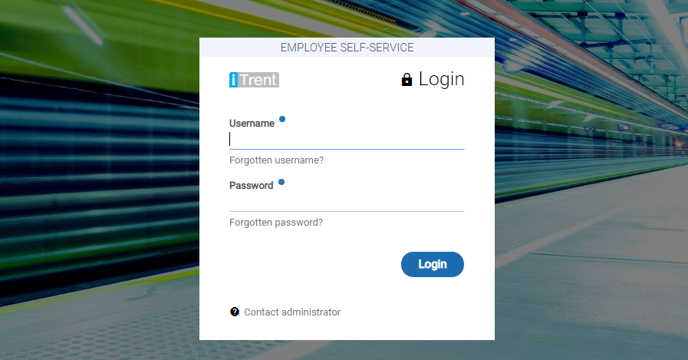

How to make a claim
You will initially be given a username and password when your payroll record is first created, on your
first log in you will then be prompted to change your password.
The homepage will contain the payroll cut off dates
and the ICAEW Privacy notice:

Slide 32
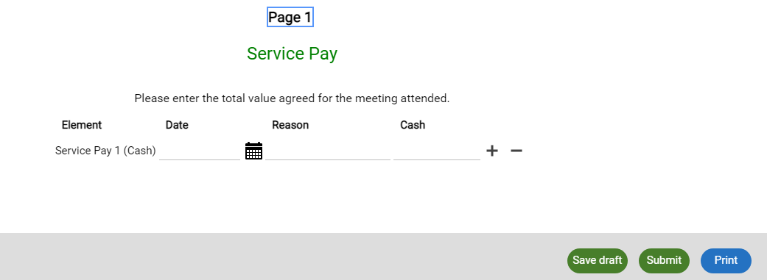
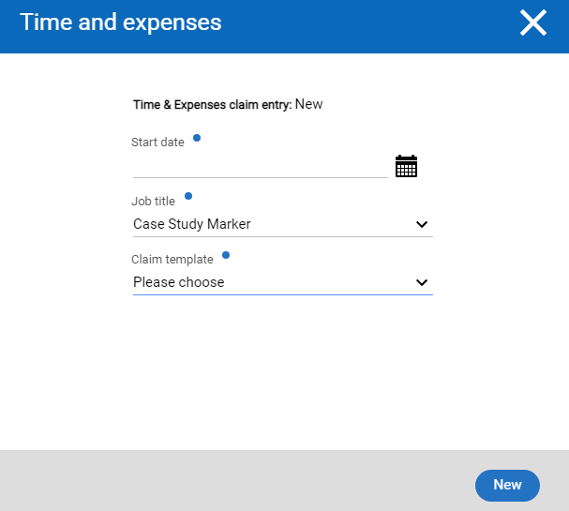
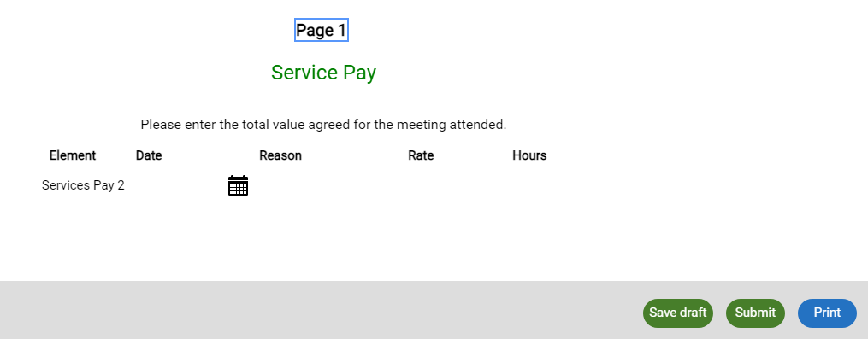
When your statement of works is
complete, you will need to log into the
payroll portal and make your claim for
the agreed fee. The start date of your
claim will be the date the claim is entered
Once you have selected to claim ‘service pay’ from
the claim template below, you can claim a cash
value or a rate (per paper) as preferred.

Slide 33
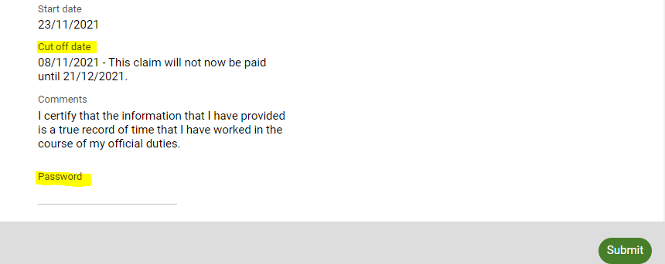
Once you have completed your claim, the system will ask you to put in your password again
(from your original log in) and will also advise you when your claim will be paid. Once the
Password has been entered, please select submit.

Slide 34
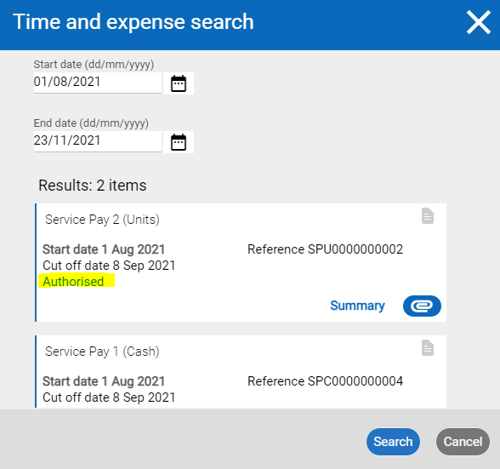
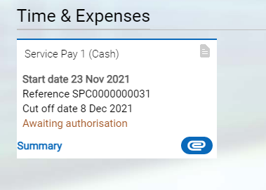
Once the claim has been
authorised you will receive an
email notifying you and confirming
when you will be paid. You will also
be able to search all previous
claims using the date range
function:

Slide 35
Q&A
ICAEW Shaun Robertson – Director, Education and Qualifications

Slide 36
Final words / Next steps
ICAEW Helen Carter – Head of Central Operations

Slide 37
2021

